Slide 1
Java JDBC Tutorial

Slide 2
Java programming language has in-build support for database processing.
In uses the technology JDBC(Java Database Connectivity)
JDBC is a set of classes and interfaces for allowing any java application to work with an RDBMS in a uniform manner.

Slide 3
JDBC Concept
App A
App B
APP C
JDBC layer
SQL
DB2
Oracle

Slide 4
definition
Java JDBC is a java API to connect and execute query with the database. JDBC API uses jdbc drivers to connect with the database.

Slide 5
Why use JDBC
Before JDBC, ODBC API was the database API to connect and execute the query with the database. But, ODBC API uses ODBC driver which is written in C language (i.e. platform dependent and unsecured). That is why Java has defined its own API (JDBC API) that uses JDBC drivers (written in Java language).
We can use JDBC API to handle database using Java program and can perform the following activities:
Connect to the database
Execute queries and update statements to the database
Retrieve the result received from the database.

Slide 6
JDBC Driver
JDBC Driver is a software component that enables java application to interact with the database. There are 4 types of JDBC drivers:
JDBC-ODBC bridge driver
Native-API driver (partially java driver)
Network Protocol driver (fully java driver)
Thin driver (fully java driver)

Slide 7
1) JDBC-ODBC bridge driver
The JDBC-ODBC bridge driver uses ODBC driver to connect to the database. The JDBC-ODBC bridge driver converts JDBC method calls into the ODBC function calls. This is now discouraged because of thin driver.

Slide 8
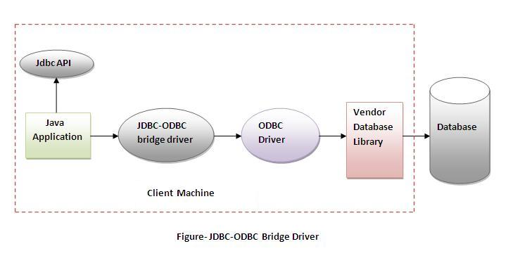

Slide 9
Advantages:
easy to use.
can be easily connected to any database.
Disadvantages:
Performance degraded because JDBC method call is converted into the ODBC function calls.
The ODBC driver needs to be installed on the client machine.

Slide 10
2) Native-API driver
The Native API driver uses the client-side libraries of the database. The driver converts JDBC method calls into native calls of the database API. It is not written entirely in java.

Slide 11
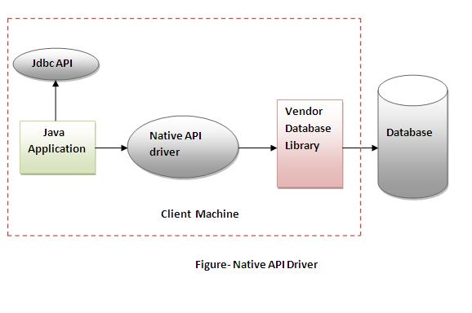

Slide 12
Advantage:
performance upgraded than JDBC-ODBC bridge driver.
Disadvantage:
The Native driver needs to be installed on the each client machine.
The Vendor client library needs to be installed on client machine.

Slide 13
3) Network Protocol driver
The Network Protocol driver uses middleware (application server) that converts JDBC calls directly or indirectly into the vendor-specific database protocol. It is fully written in java.

Slide 14
Advantage:
No client side library is required because of application server that can perform many tasks like auditing, load balancing, logging etc.
Disadvantages:
Network support is required on client machine.
Requires database-specific coding to be done in the middle tier.
Maintenance of Network Protocol driver becomes costly because it requires database-specific coding to be done in the middle tier.

Slide 15
Thin Driver
Thin driver
The thin driver converts JDBC calls directly into the vendor-specific database protocol. That is why it is known as thin driver. It is fully written in Java language.

Slide 16
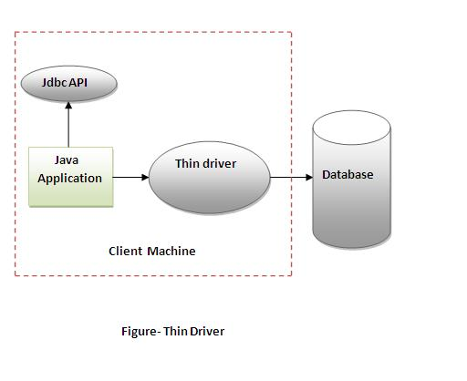

Slide 17
Advantage:
Better performance than all other drivers.
No software is required at client side or server side.
Disadvantage:
Drivers depends on the Database.

Slide 18
5 Steps to connect to the database in java
There are 5 steps to connect any java application with the database in java using JDBC. They are as follows:
Register the driver class
Creating connection
Creating statement
Executing queries
Closing connection

Slide 19
1) Register the driver class
Class.forName("oracle.jdbc.driver.OracleDriver");
The forName() method of Class class is used to register the driver class. This method is used to dynamically load the driver class.

Slide 20
Example to register the OracleDriver class
Here, Java program is loading oracle driver to esteblish database connection.
Class.forName("oracle.jdbc.driver.OracleDriver");

Slide 21
Example to Connect Java Application with mysql database
Class.forName("com.mysql.jdbc.Driver");

Slide 22
2) Create the connection object
Connection con=DriverManager.getConnection(
"jdbc:oracle:thin:@localhost:1521:xe","system","password");
The getConnection() method of DriverManager class is used to establish connection with the database.

Slide 23
3) Create the Statement object
Statement stmt=con.createStatement();
The createStatement() method of Connection interface is used to create statement. The object of statement is responsible to execute queries with the database.

Slide 24
4) Execute the query
ResultSet rs=stmt.executeQuery("select * from emp");
while(rs.next()){
System.out.println(rs.getInt(1)+" "+rs.getString(2));
}

Slide 25
5) Close the connection object
con.close();

Slide 26
DriverManager class
The DriverManager class acts as an interface between user and drivers. It keeps track of the drivers that are available and handles establishing a connection between a database and the appropriate driver.

Slide 27
JDBC - Statements, PreparedStatement and CallableStatement
Once a connection is obtained we can interact with the database. The JDBC Statement, CallableStatement, and PreparedStatement interfaces define the methods and properties that enable you to send SQL or PL/SQL commands and receive data from your database.

Slide 28
Interfaces | Recommended Use
Statement | Use the for general-purpose access to your database. Useful when you are using static SQL statements at runtime. The Statement interface cannot accept parameters.
PreparedStatement | Use the when you plan to use the SQL statements many times. The PreparedStatement interface accepts input parameters at runtime.
CallableStatement | Use the when you want to access the database stored procedures. The CallableStatement interface can also accept runtime input parameters.

Slide 29
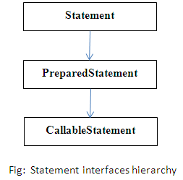

Slide 30
Statement interface
The Statement interface provides methods to execute queries with the database. The statement interface is a factory of ResultSet i.e. it provides factory method to get the object of ResultSet.
Commonly used methods of Statement interface:
The important methods of Statement interface are as follows:
1) public ResultSet executeQuery(String sql): is used to execute SELECT query. It returns the object of ResultSet.
2) public int executeUpdate(String sql): is used to execute specified query, it may be create, drop, insert, update, delete etc.
3) public boolean execute(String sql): is used to execute queries that may return multiple results.
4) public int[] executeBatch(): is used to execute batch of commands.

Slide 31
Example
Statement stmt = con.createStatement();
ResultSet rs = stmt.executeQuery("select * from xyz");

Slide 32
PreparedStatement interface
The PreparedStatement interface is a subinterface of Statement. It is used to execute parameterized query.
Let's see the example of parameterized query:
String sql="insert into emp values(?,?,?)";
As you can see, we are passing parameter (?) for the values. Its value will be set by calling the setter methods of PreparedStatement.

Slide 33
Why use PreparedStatement?
Improves performance: The performance of the application will be faster if you use PreparedStatement interface because query is compiled only once.

Slide 34
CallableStatement Interface
CallableStatement interface is used to call the stored procedures and functions.

Slide 35
How to get the instance of CallableStatement?
The prepareCall() method of Connection interface returns the instance of CallableStatement. Syntax is given below:
public CallableStatement prepareCall("{ call procedurename(?,?...?)}");

Slide 36
The example to get the instance of CallableStatement is given below:
CallableStatement stmt=con.prepareCall("{call myprocedure(?,?)}");
It calls the procedure myprocedure that receives 2 arguments.

